Slide 1

Polyglot Programming
How to do It right ?

Slide 2
Praseed Pai KT
Sr. Solutions Architect
Gadgeon Smart Systems Pvt Limited
Kochi, India

Slide 3

About the Presenter
A Seasoned Software Engineering Professional with more than twenty five years of Exposure
Author of Two books on Computer Programming
Explorer in “Philosophical Tools for Software Engineering” ( Has Presented on it, Written one university accredited
paper, Designed a Pattern based on Advaita Vedanta to transition from OOP to FRP)
An Expert level professional in Cross Cultural Encounters
A Critique of Digital Technology Fads ( Programmers will be better off , if they stick to Programming. Do not run
after so called AI/ML, BlockChain etc ) - “Plumbing is preferred over Painting!”
Has Presented in more than three hundred sessions in the past twenty five years
I also help Programmers eliminate their “Math-Phobia”
Currently designated as “Sr. Solutions Architect @ Gadgeon”

Slide 4
Gist of the Presentation
Polyglot - The term and it’s meaning
Poly-this,Poly-that --- How do u make sense of it?
Programming – Formal Models/Paradigms/Compilation/Expressive Power/Intent
specification ( How to view PL landscape?)
Encoding Architecture/Design/Models/Techniques in a Language Agnostic Manner.
How to Transfer Ontology/Idioms/Patterns/Style from One language to another?
Pragmatics of working as a Polyglot Professional
Anecdotes/Case Studies/Stories/Events which mandated Polyglot development.

Slide 5
Putting things into Context

Slide 6

Let us meet
Kato Lomb!

Slide 7
Q&A with Kato Lomb
Question: Is it possible to know 16 languages?
Answer: No, it is not possible—at least not at the same level of ability. I only have one mother tongue: Hungarian. Russian, English, French, and German live inside me simultaneously with Hungarian. I can switch between any of these languages with great ease, from one word to another.
Translating texts in Italian, Spanish, Japanese,Chinese, and Polish generally requires me to spend about half a day brushing up on my language skills and perusing the material to be translated.
The other six languages [Bulgarian, Danish, Latin, Romanian, Czech, Ukrainian] I know only through translating literature and technical material.
Question: Why haven’t you chosen a career in foreign language teaching?
Answer: In order to teach, it is not enough to have mastered a whole army of languages. To look it at another way, surely there are many unfortunate people who have needed to undergo multiple stomach surgeries. Yet no one would hand a scalpel over to them and ask them to perform the same surgery they received on another person, simply because they themselves had undergone it so often.If those individualswho conduct surveys and polls had a sense of humor when asking us our occupations, my answer would be “language learner.”
Question: Does one need an aptitude to learn so many languages?
Answer: No, it is not necessary. A side from mastery in the fine arts, success in learning anything is the result of genuine interest and amount of energy dedicated to it. In my own experience learning languages, I have discovered many useful principles. This book outlines them for you.
I wish to acknowledge that my achievement in languages is due to my collaborators over the years, known and unknown. This book is dedicated to them.

Slide 8
Why we (Indians) are natural Polyglots?
Before I move into the techniques , I would like to write a word of encouragement for Indians. We have got "polyglot" gene ( ala "math gene" ),
embedded inside us because of the multilingual environment we are in.
An average Indian , will master at least three languages
A) Native Tongue (Malayalam,Tamil,Kannada,Oriya etc)
B) English ( Lingua franca of the world )
C) Hindi ( being the national language )
Only exceptions are people in Hindi Heartland , where they might learn only two (Hindi/English) In the case of Keralites, Tamil as an additional language by virtue of Tamil Film Industry. A person like me will have one more tongue as I speak Konkani at home. Additionally,I have studied Japanese ( Hiragana, Katakana and 150 words of Kanji ) Can an Indian afford to say that he will speak only one language ? So,becoming polyglot in natural languages is natural for us.
Why cannot we extrapolate this instinct into Programming languages ?

Slide 9
A Word of Caution!
“Most people consider spending time on learning additional programming language is a waste of time . In the name of focus, some headhunters do reject people with skills in multiple languages and technologies. Those are "political" problems which this series do not consider. The topics are dealt at a cognitive level over here”
- Praseed Pai (from the blog, ”Analysis leads to Paralysis”)

Slide 10
Whet your appetite!

Slide 11
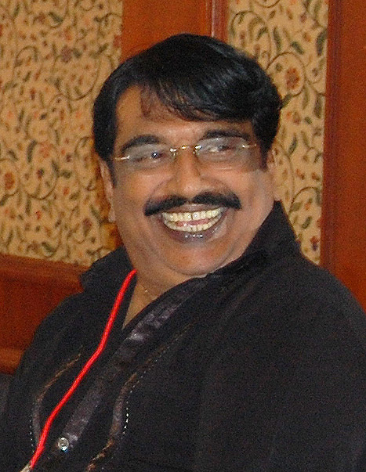
Comparative Study of Programming Languages
In India , it is like this. I do not how it is in Punjab? – Punjabi House

Slide 12
Programming Languages – A Model driven reality
By Formal Models – Turing Machine/Lambda Calculus/Predicate Logic based Languages
By Typing – Static/Dynamic and Type annotation based languages
By Expressive Power – Turing Complete and Otherwise languages
By Compilation Strategy – Compiled/Semi-Compiled and Quasi Compiled ( Interpreted languages)
By Programming Paradigms – Procedure/Functional/Logic/Object Procedural/Object Functional
By Intent specification – Declarative vs Procedural

Slide 13
A Tactical Approach towards Learning Multiple Languages
Hello Script in Python/Java/Ruby
Maintain a Text File of Executable Code snippets
Pros
A Bootstrapping Strategy
A Handy Tool for “Assembling” Code very fast
Please your boss!
Cons
Too much Axiology driven
Cannot exploit deeper synergies between languages

Slide 14
Let us Jump into the water!
A Straight Line Program which accepts a list of numbers as command line arguments and sort them, to print to the Console
Implementation in Java/C#/Python/JS
Improving the above program by Data Parametrization
Implementation in Java/C#/Python/JS
Improving the above program by adding Type Parametrization
Implementation in Java/C#/Python/JS
Improving the above program by adding Behaviour Parametrization
Implementation in Java/C#/Python/JS

Slide 15
Three Kinds of Polyglots
So called “Full Stack” developers (Seemingly Polyglot )
Modern Software Developers (Polyglot by Imperative )
True Polyglots ( Polyglots by choice )

Slide 16
An Unusual story of JavaScript

Slide 17
A Story of JavaScript
A Programmer was asked by his “boss” (in 1995) to design a language with following attributes
Simple
Modern
To be used by Casual Programmers
Embeddable inside a Browser
A Choice made by that programmer had deep consequences and resulted in “grotesque” language for those times.
Years later, when processing power improved, that language morphed into a “ubiquitous language”

Slide 18
Simple means “Dynamic Typing”
Bane of newbies is “Static Typing”
Brendon Eich chose Dynamic Typing
var a = 2;
b = 2.3
console.log(a/b);
a = "Hello World..";
console.log(a/b);
a = new Date();
b = "ddd";
console.log(a/b);
a = 3.0;
b = 0;
console.log(a/b);

Slide 19
Modern means “OOP (in 1995)”
Three Kinds of OOP
Class based OOP
Actor based OOP (Event based)
Prototype OOP
Class based OOP is apt for Static Typing
Actor based OOP might result in “Event Cacophony”
The only choice available is “Prototype OOP”
Prototype treats Objects as dictionary
How to reduce a class to Key/Value dictionary?
What constitutes a class?
Static and Instance variables & Static and Instance methods
var a = {};
a.test = 10;
console.log(a.test);
a["test"]=20;
console.log(a.test);

Slide 20
How to reduce Object into Value?
//////////////////////////////////
//
// Clone Temp1 object to create temp2
//
var temp1 = new Person("T",0,1000);
var newobj = {};
for( var n in temp1 )
{
newobj [n] = temp1[n];
}
temp1.SayHello = function() {
console.log("I did a dirty trick");
}
newobj ["SayHello"]();
temp1 ["SayHello"]();
Variables can be mapped into key/value
Static variables can be mapped into key/value in prototype
Reference to Static Map is placed inside each Object
How to reduce Method to Key/Value?
We need a paradigm which treats Method/Function as value
Functional Programming fits the Bill
Support for functional programming was added to support prototype OOP

Slide 21
An “argument” with a world renowned personality
Only few people have got ability to assemble circuits which requires precision. Only those guys need to learn from Fablab.
What If someone wants to learn stuff for understanding it or to take executive decision on a stuff?
……
…….
…….
“ Why should you learn something which is not going to be used”?
“I would like to learn a stuff to reason about it!
Learn for Reasoning!

Slide 22
Some Conceptual Tools for Polyglot Programming

Slide 23
Let us Discuss these Three Things
What is the primary difference between Stored Procedure and a Stored Function in the case of RDBMS Software?
Have u Come across a Declarative Language in an Imperative Language and Vice Versa ?
Please name a Reference Type which obeys value semantics in Java and C#?

Slide 24
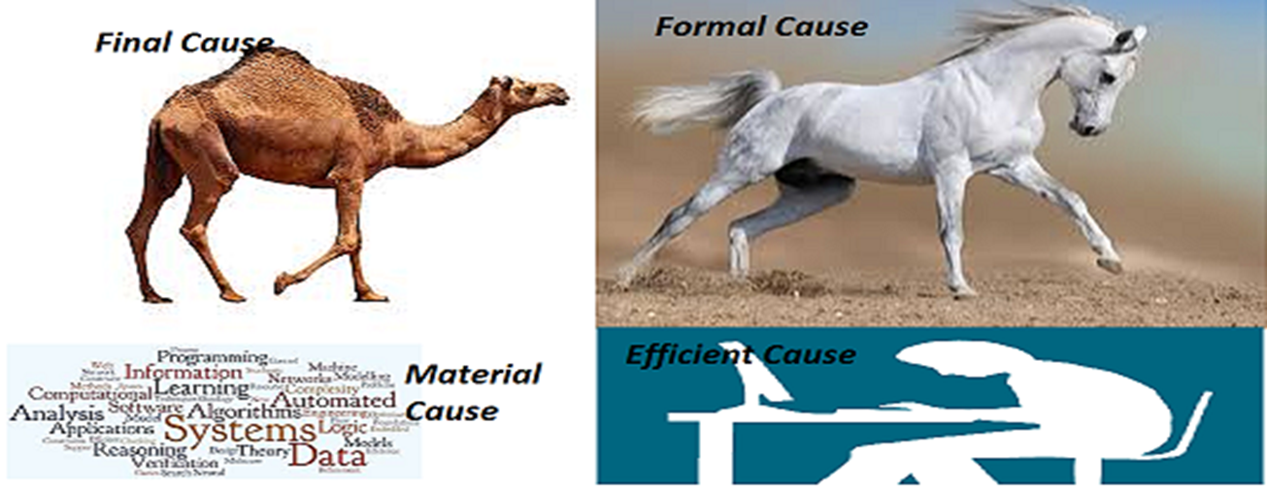
A Camel is a horse designed by a committee – Perils!

Slide 25
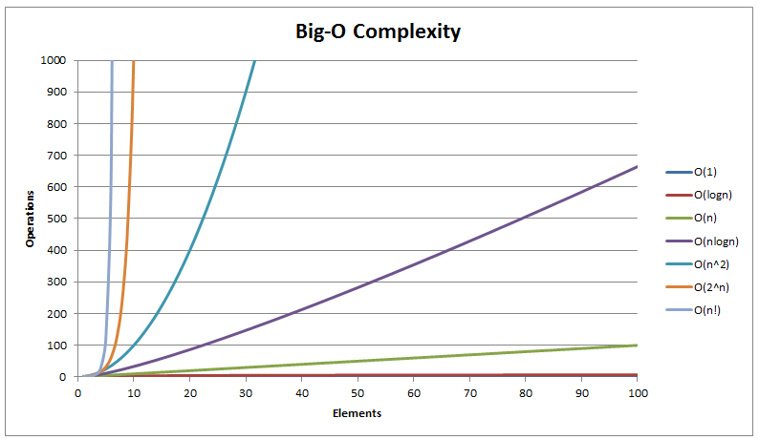
Algorithmic Complexity

Slide 26
Three Programs to demonstrate Intractability
Permuation
SubSet
Data set generation

Slide 27
Algorithmic Landscape
After you have tried If/else/while/select/update programming Linear/Quadratic complexity algorithms Patented algorithms Heuristics based solutions Approximate Solutions Stochastic solutions All of the above are control path programming. When these fail you can opt for Machine learning based solutions which will reason based on data.

Slide 28
Linear Algebra through Programming

Slide 29
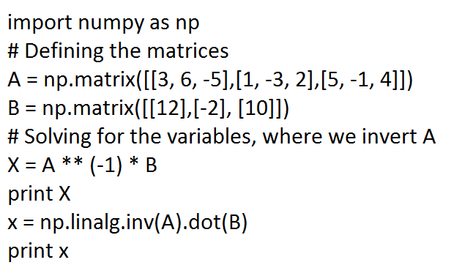
Learn Matrix Algebra through Python

Slide 30
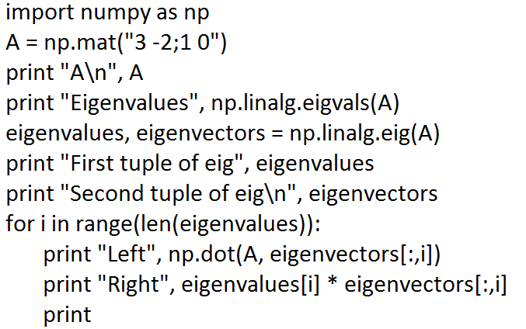
Eigen Value – Python Code

Slide 31
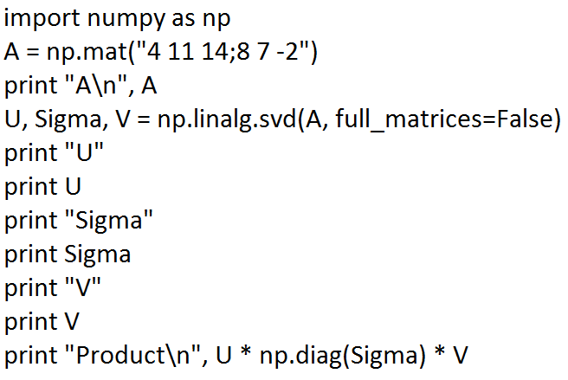
SVD

Slide 32
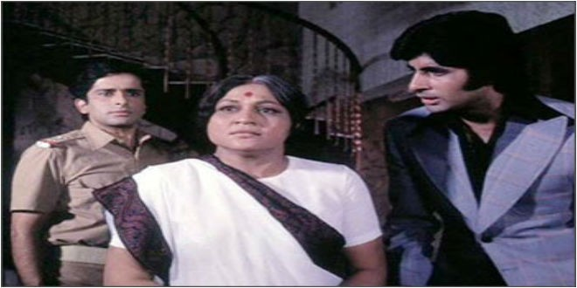
Which Language is important?
Aaj mere paas building(C++) hai, property(C#) hai ,bank balance (Java) hai, bungla(Python) hai,gaadi hai(PHP) Kya hai, Kya hai tumhare paas?....Mere Paas Maa (JavaScript) hai

Slide 33
Going Native! & Interfacing with it!

Slide 34
Native Code Programming
Compile/Link/Load cycle under Windows and POSIX
Static Linking of libraries
How to Create DLLs and Shared Objects (.so) in Windows and GNU Linux ?
32 bit vs 64 bit DLLs
Three Ways to invoke DLLs/Sos in Windows and GNU Linux
Linking with import library ( Loaded at the Load time of the executable)
On the fly loading of the DLL

Slide 35
Mixed Language Programming
How to invoke native code libraries?
Invoking native libraries written in C/C++ from C#
Invoking native libraries written in C/C++ from Java
Invoking native libraries written in C/C++ from Python
Importance of Mixed Language Programming
Jython and Jruby – Two case studies

Slide 36
Programming Paradigms
Programming Paradigms and their origins

Slide 37
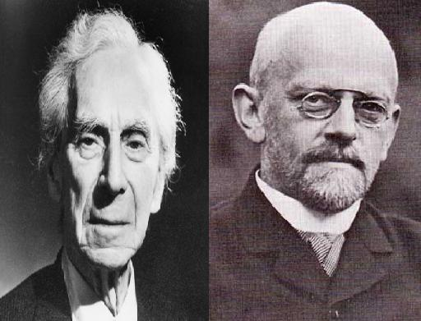
Who are they?

Slide 38
A Tale of two mathematicians
Bertrand Russell and David Hilbert spear headed a plan to reduce entire mathematics to Logic.
Hilbert’s 23 problems
Bertrand Russell and Alfred north Whitehead’s Principia Mathematica.
Barber Paradox – The Quagmire

Slide 39
Entscheidungsproblem (Decision Problem)
The problem of algorithmically determining whether a First Order Logic statement is universally valid
First Order Logic – Propositional Calculus + Predicate Calculus

Slide 40
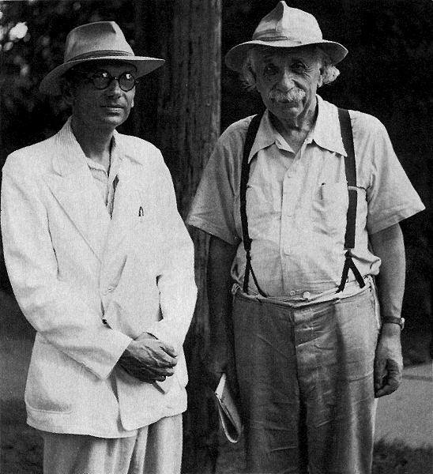
Who are they ?

Slide 41
KURT GODEL
Austrian Logician who proved the incompleteness theorem
Mathematics is not consistent ?
Demoralizing for the whole world
Return of the “GOD” ?

Slide 42
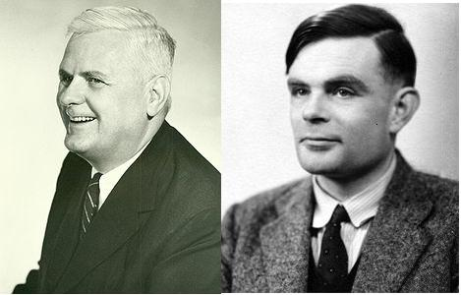
Hilbert's Scheme got broken

Slide 43
The BY-PRODUCT
Alonzo Church invented Lambda Calculus
Turing came up with the concept of Turing Machine
They were trying to solve the decision problem in the Predicate Calculus
Both Failed in finding an algorithmic procedure for the decision problem.
( Some stuff is not computable ! )‏

Slide 44
Three Programming Paradigms
Imperative Programming using C/C++,Java,C#,Perl and Visual Basic etc.
Turing Machine is the foundation.
Functional Programming using LISP,Scheme,ML,Haskell,Miranda etc.
Lambda Calculus is the foundation
Logic Programming using Prolog,DataLog, SQL etc
Based on Predicate Calculus

Slide 45
Imperative Programming
Command Oriented Programming.
Statement Oriented
Function is what u evaluate for it’s value and statement is what u execute for it’s effect.
X= X + 1 can give shiver to any person when he encounters it for the first time.

Slide 46
Functional Programming
Function as the unit of computation.
Functions can be composed arbitrarily
How can I write programs without Loop ?
Recursion is a good substitute.
Referential Transparency of the functions
Controlled manipulation of state is necessary for the real world.

Slide 47
Logic Programming
Declarative Model of computation
Logical Deduction is a medium for computation.
Has got good support for parallelism.
Heavy use of recursion and Depth first search.
Used in writing Huerisitics based programs.

Slide 48
Conclusion
Competence = Skill + Knowledge + Meta-Knowledge
Learn Programming Language Theory
Learn for Reasoning!
There are only three types of Programming paradigms
If you learn, those paradigms, every programming language is just a syntactic sugar
Be language agnostic and platform agnostic

